Slide 1


DISHA COLLEGE RAM NAGAR KOTA,RAIPUR
ORIENTATION PROGRAMME FOR STUDENT ABOUT N-LIST
BY LIBRARIAN
LOVELY GUPTA

Slide 2
What is N-LIST
The Project entitled "National Library and Information Services Infrastructure for Scholarly Content (N-LIST)", being jointly executed by the e-Shodh Sindhu Consortium, INFLIBNET Centre and the INDEST-AICTE Consortium, IIT Delhi provides for i) cross-subscription to e-resources subscribed by the two Consortia, i.e. subscription to INDEST-AICTE resources for universities and e-Shodh Sindhu resources for technical institutions; and ii) access to selected e-resources to colleges. The N-LIST project provides access to e-resources to students, researchers and faculty from colleges and other beneficiary institutions through server(s) installed at the INFLIBNET Centre. The authorized users from colleges can now access e-resources and download articles required by them directly from the publisher's website once they are duly authenticated as authorized users through servers deployed at the INFLIBNET Centre.

Slide 3
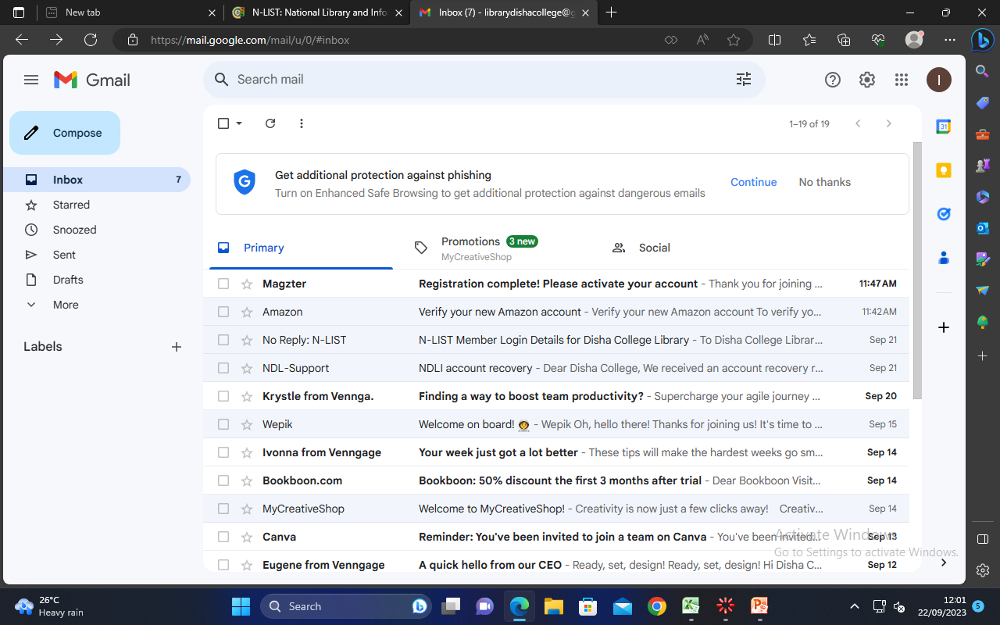
How to Activate your Account

Slide 4
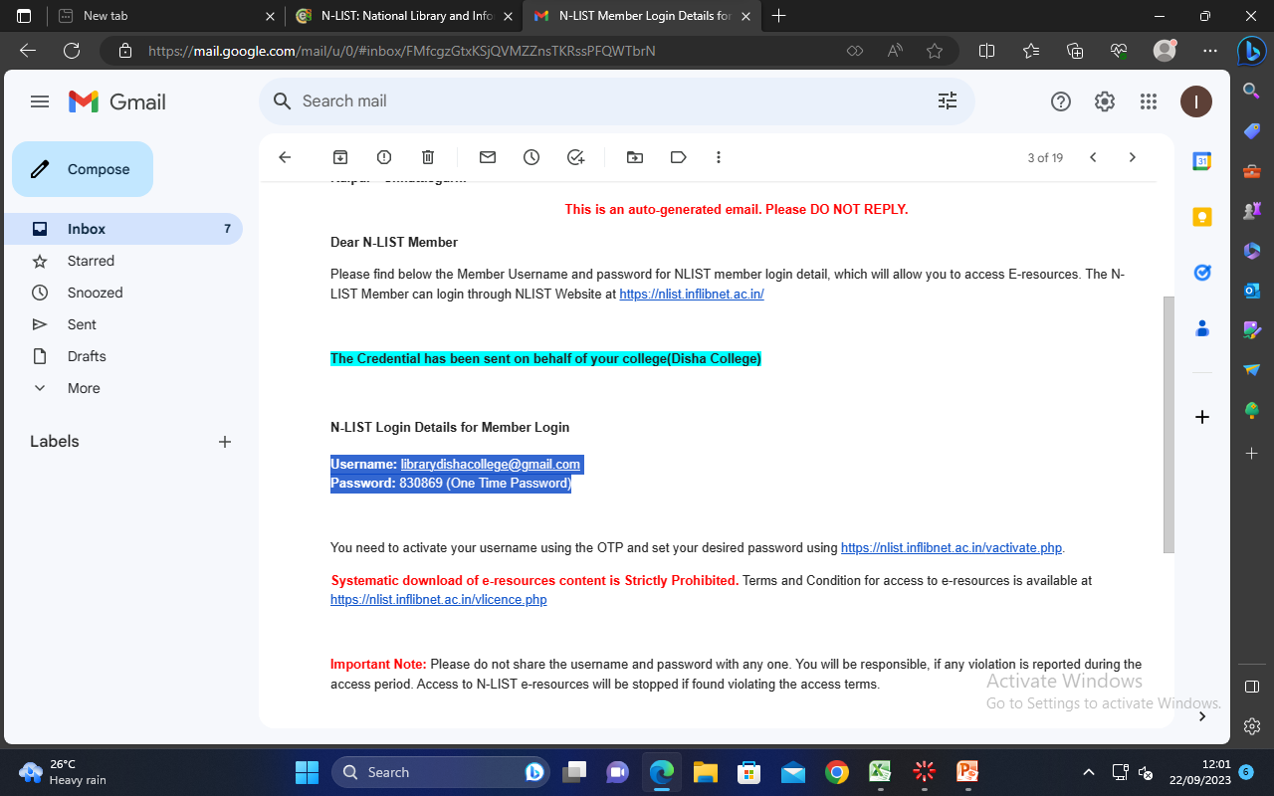

Slide 5
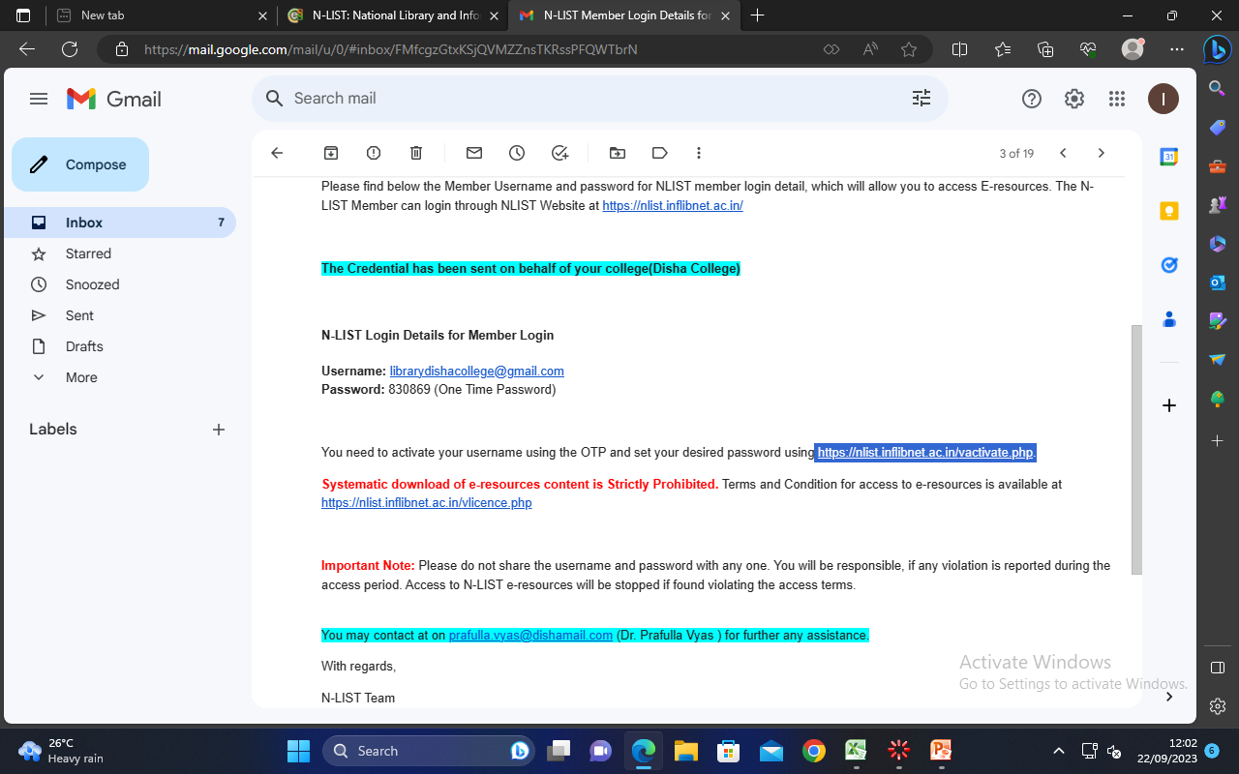

Slide 6
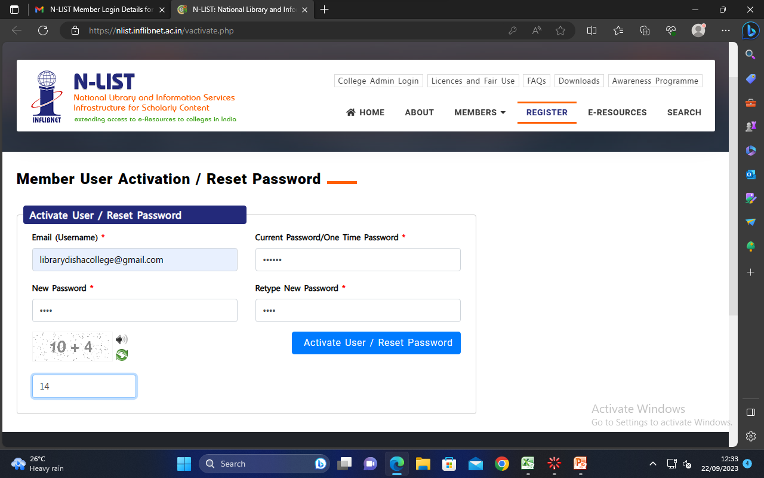

Slide 7
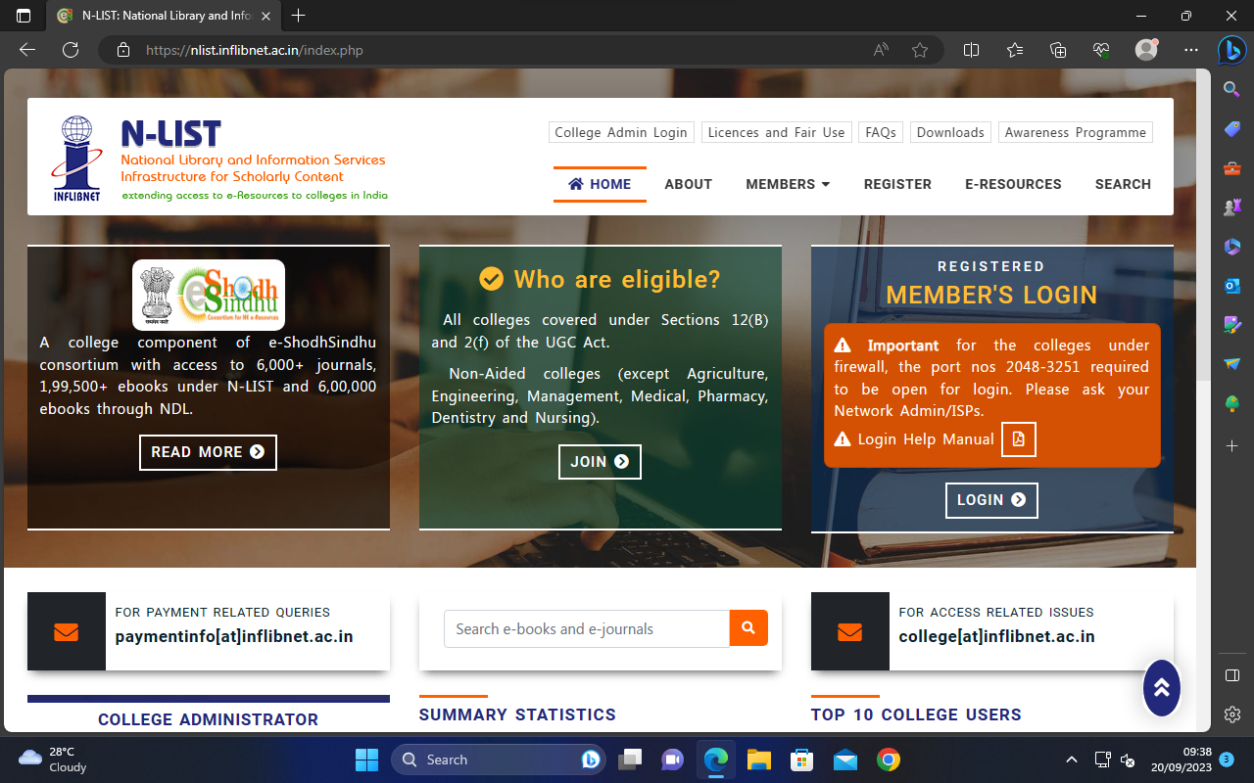
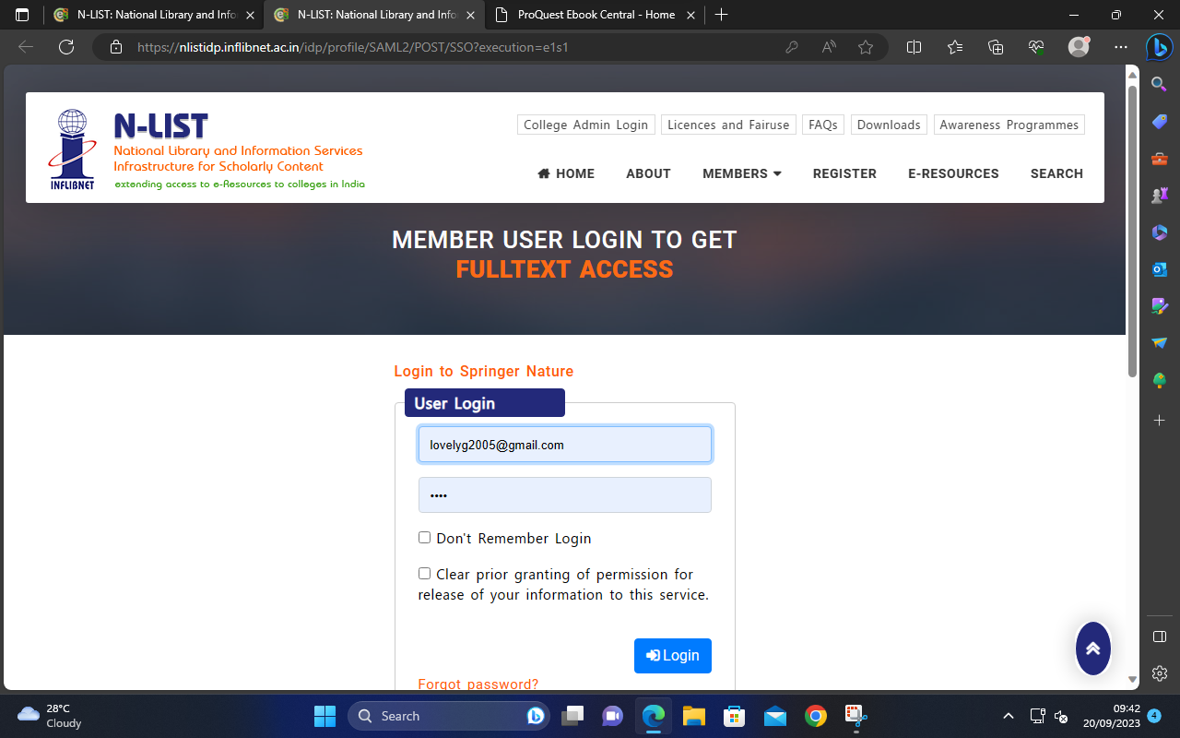
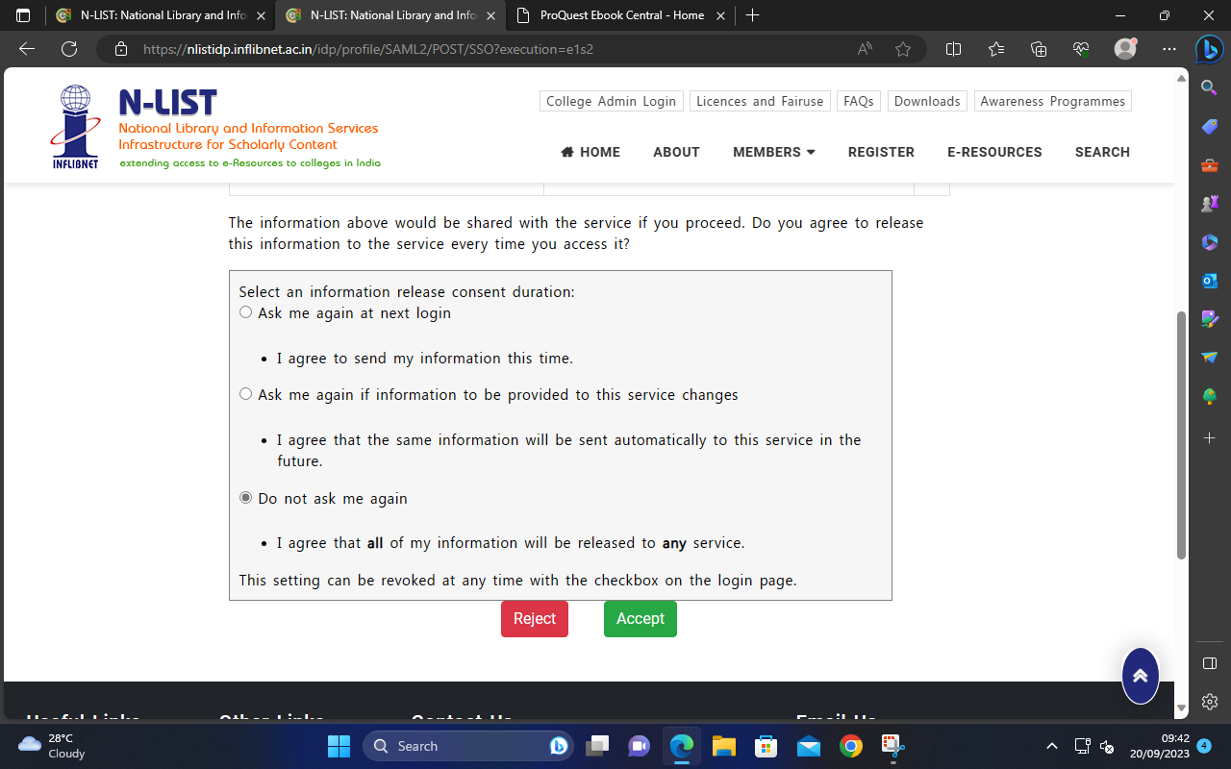

Slide 8
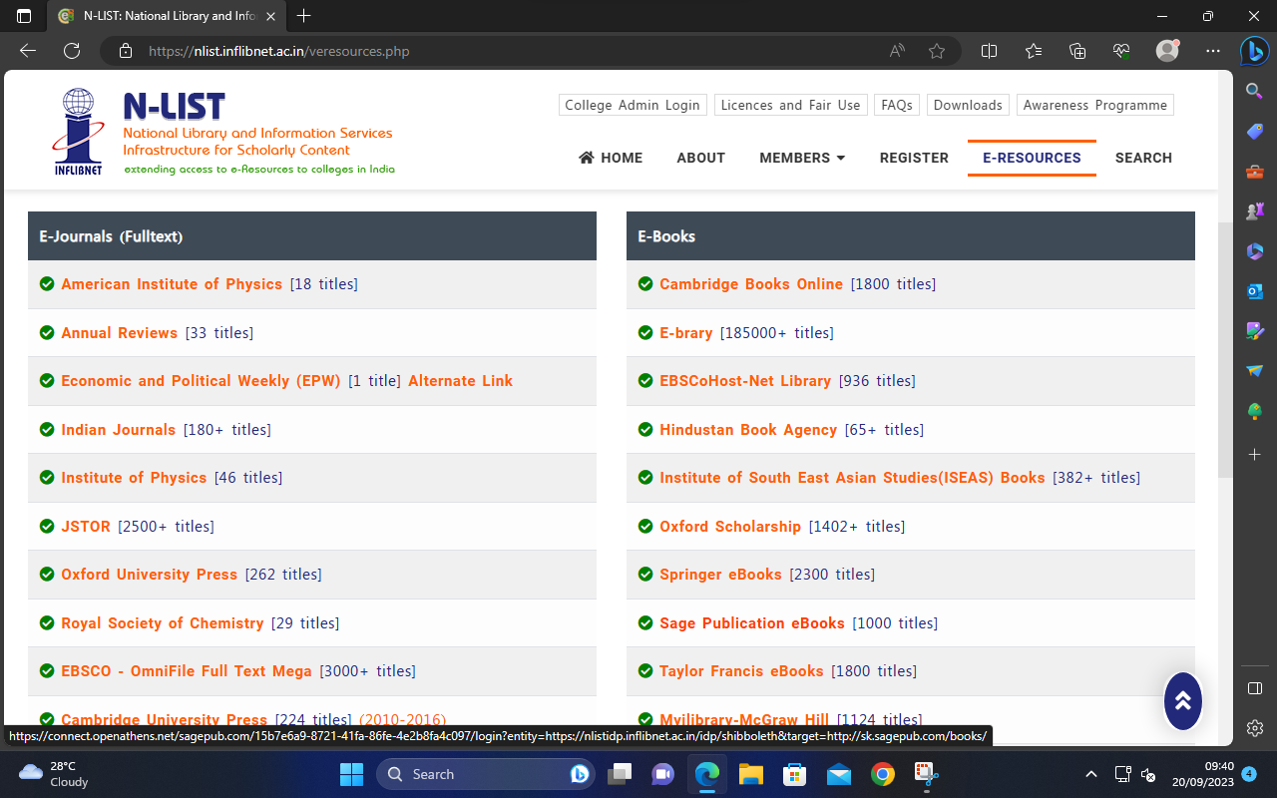

Slide 9
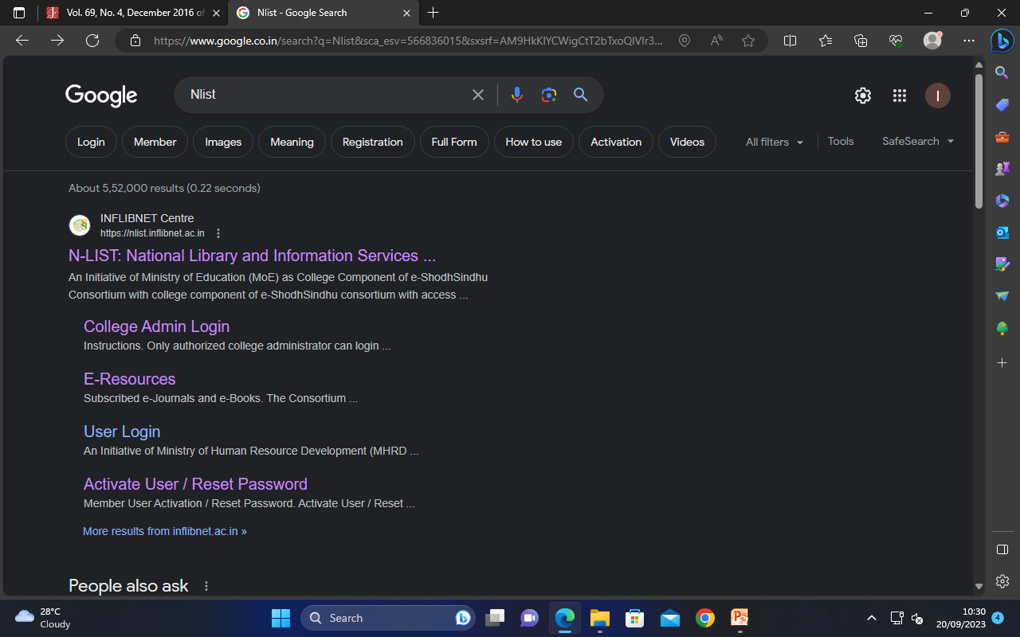
How to Access e-resources by N-List

Slide 11
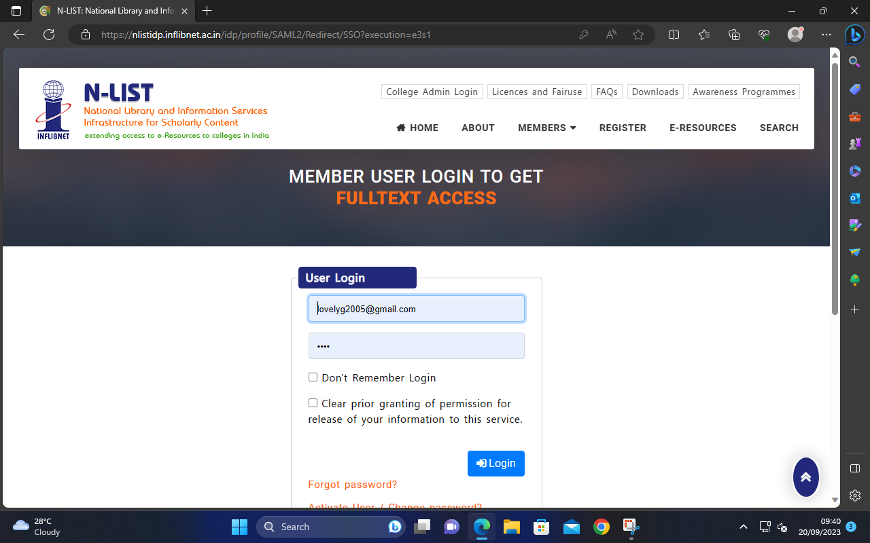

Slide 13
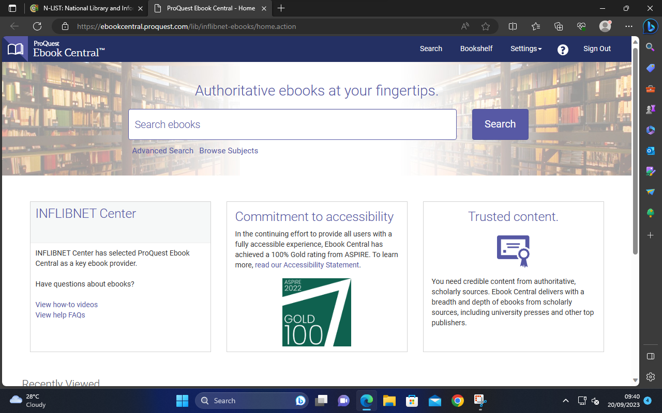
E-brary

Slide 14
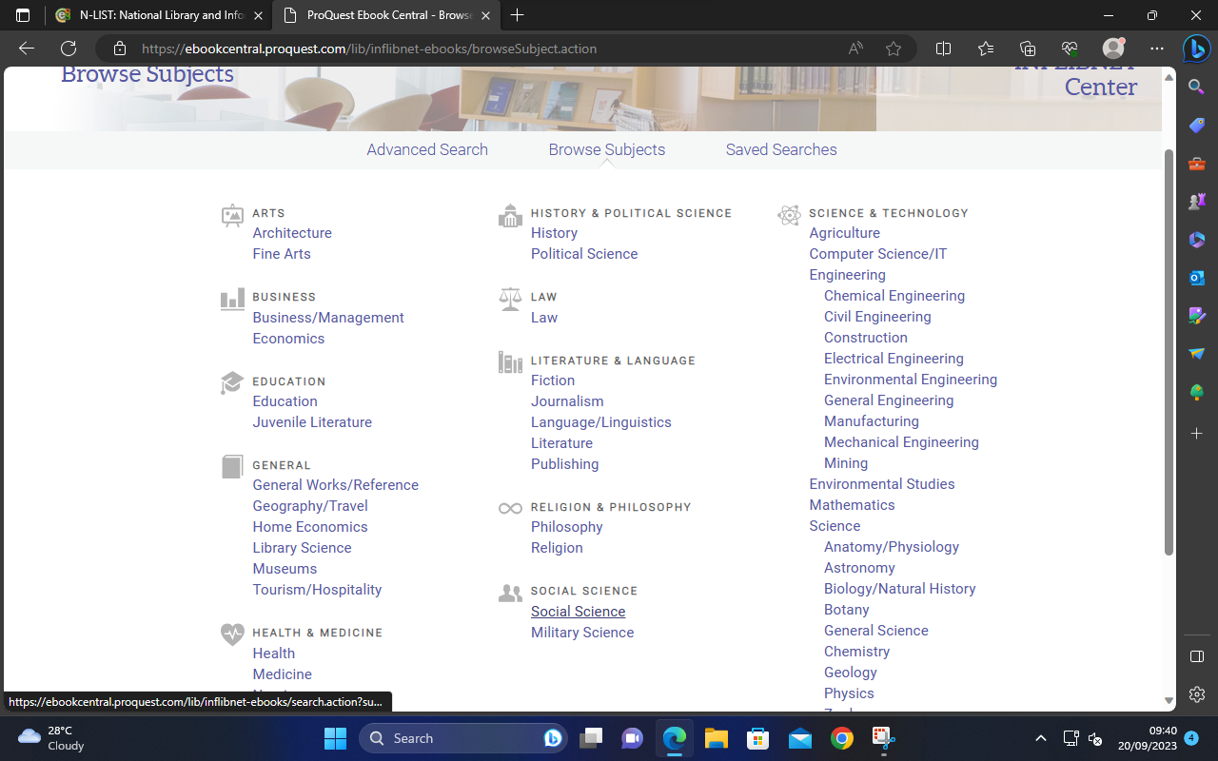

Slide 15
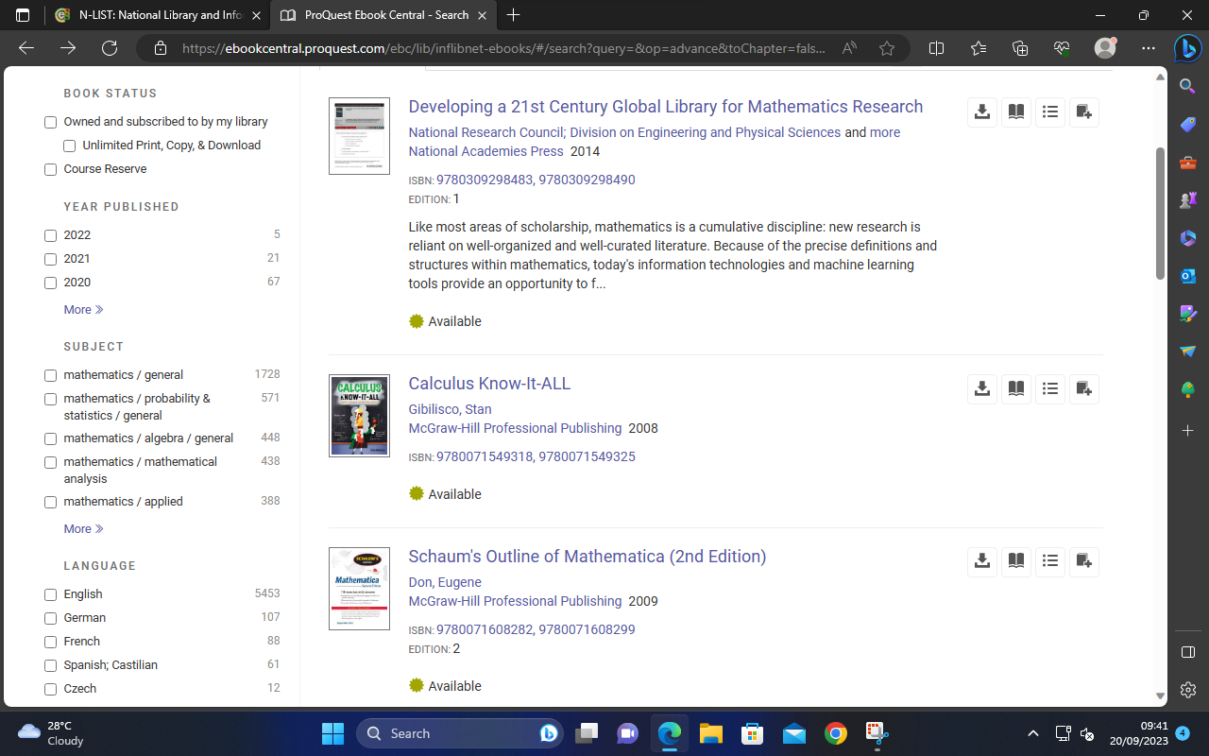

Slide 16
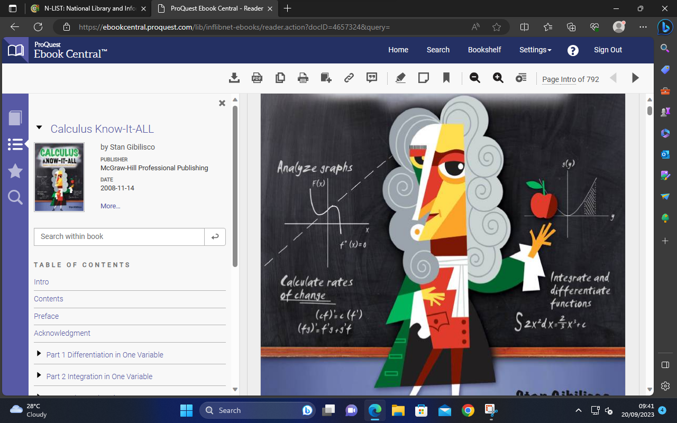

Slide 17
Springer

Slide 18
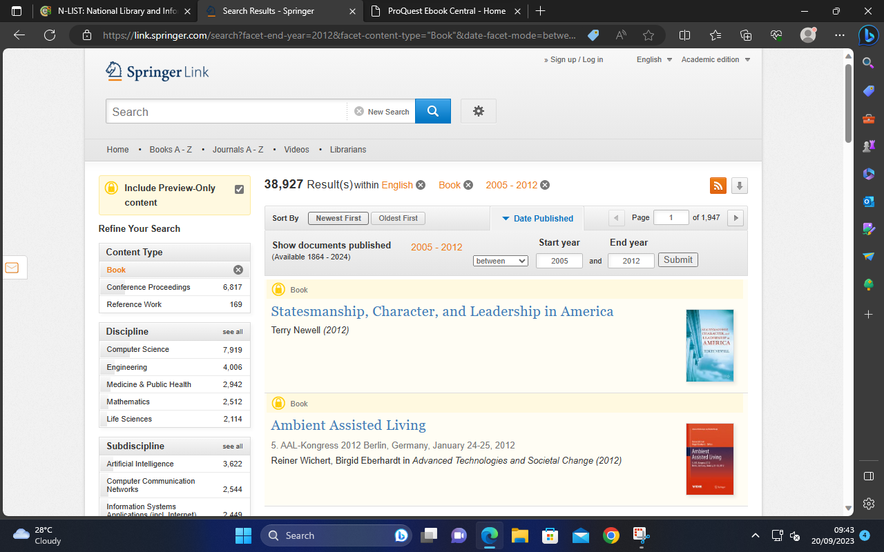

Slide 19
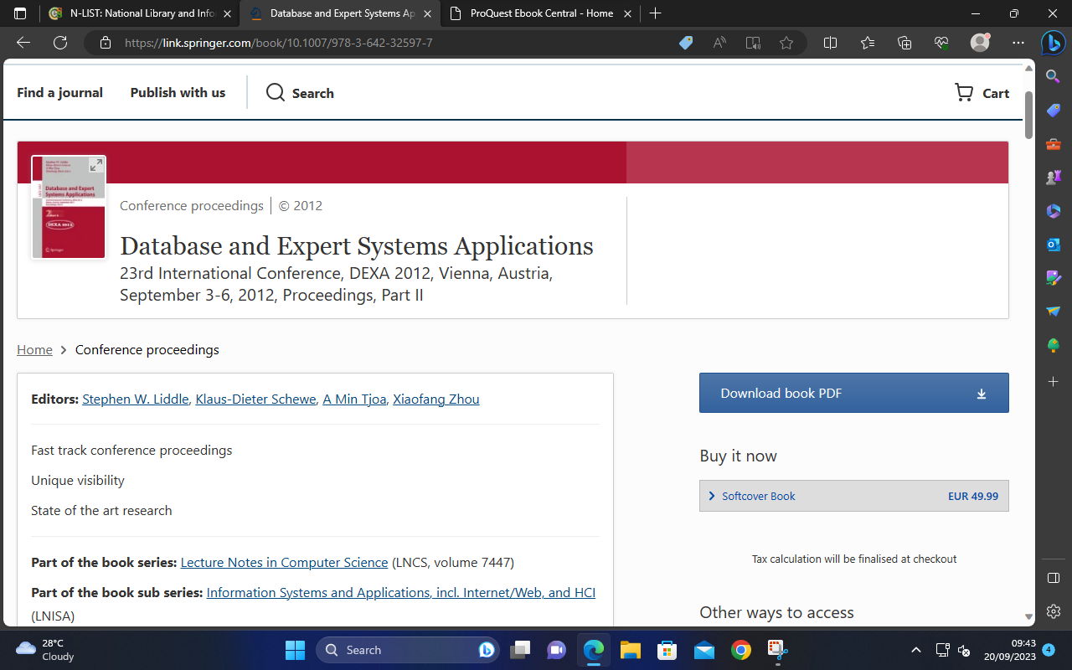

Slide 20
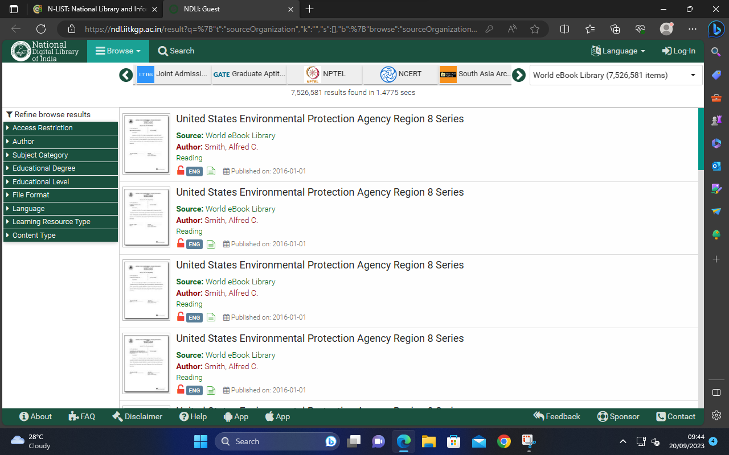
World e-book Library

Slide 21
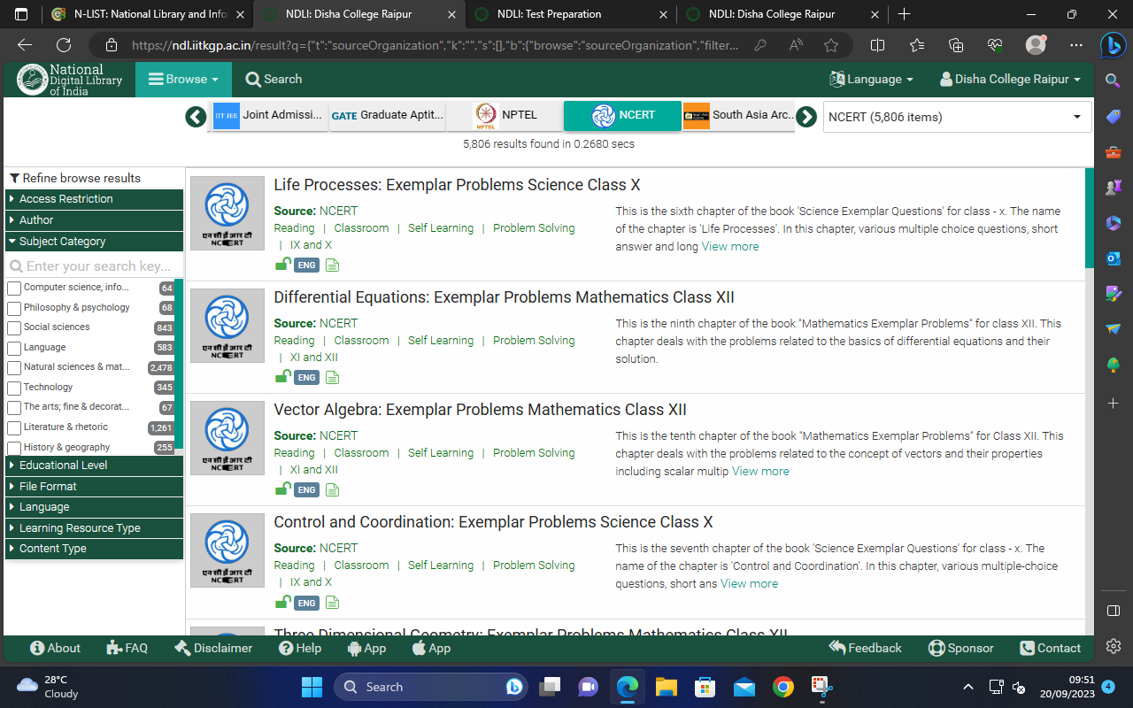
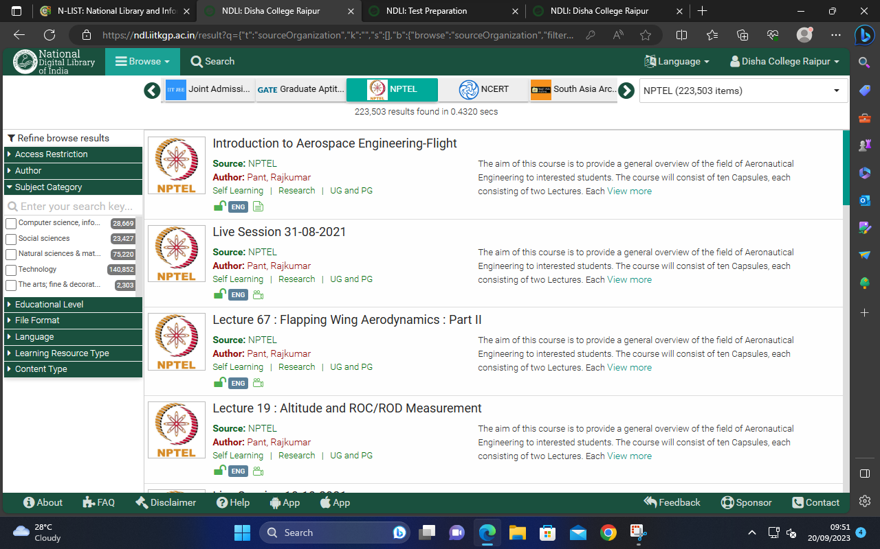

Slide 22
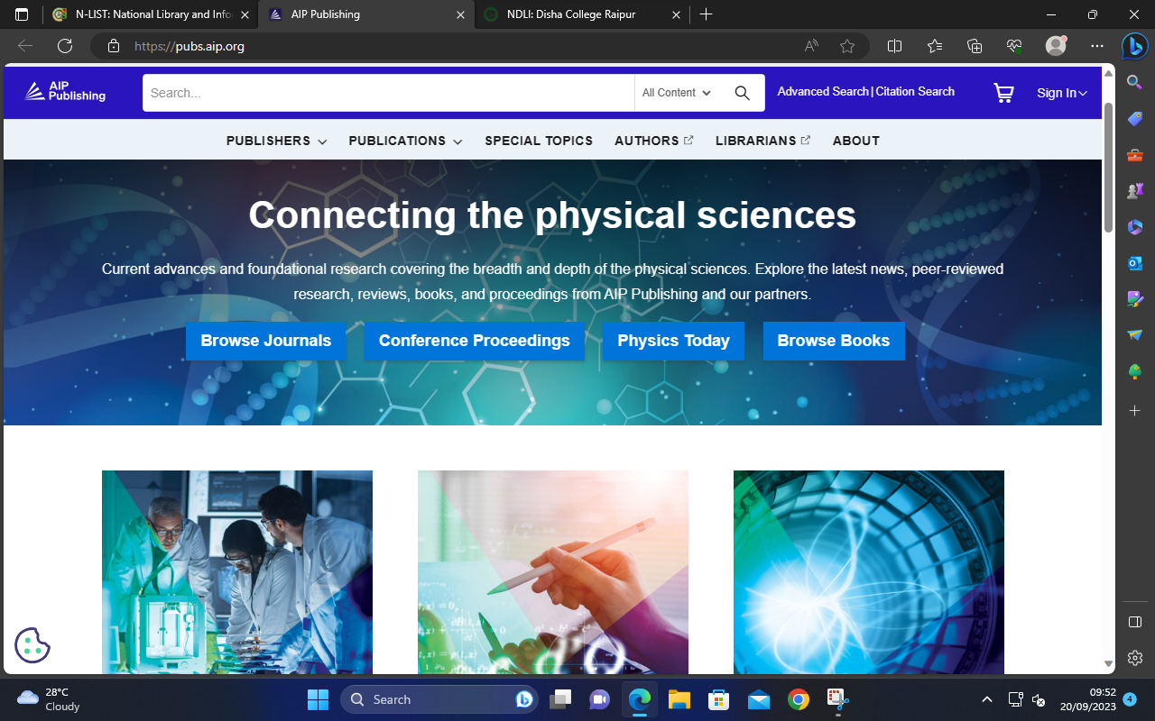
How to access E-Journals

Slide 23
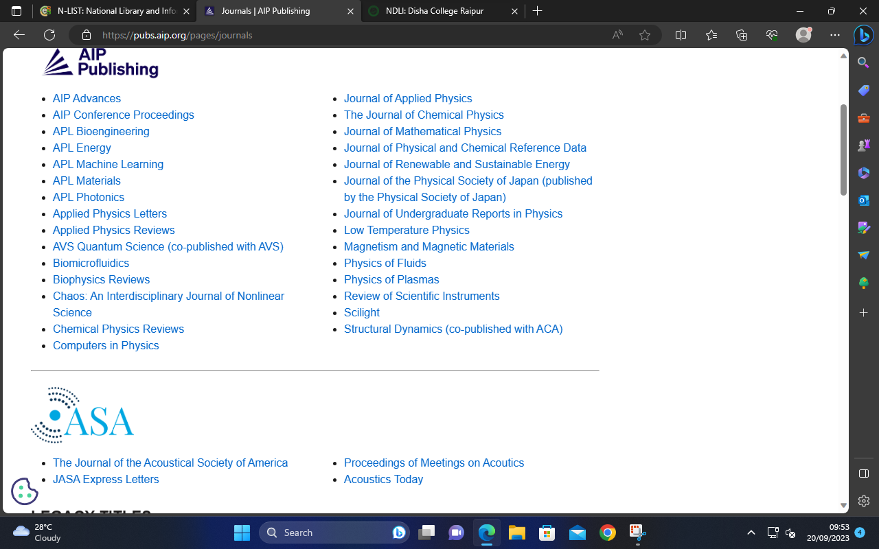

Slide 24
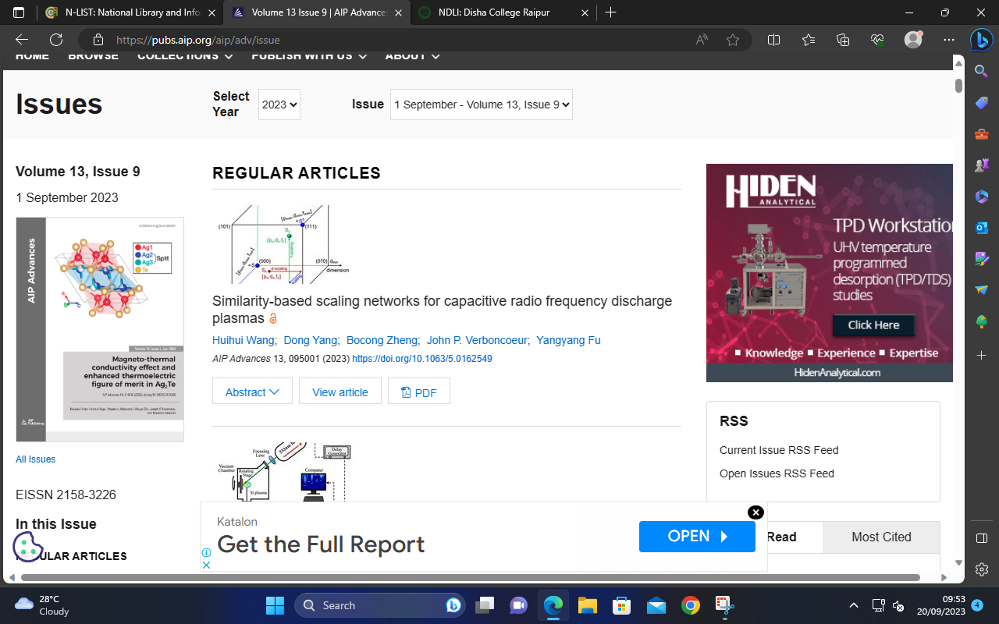

Slide 25
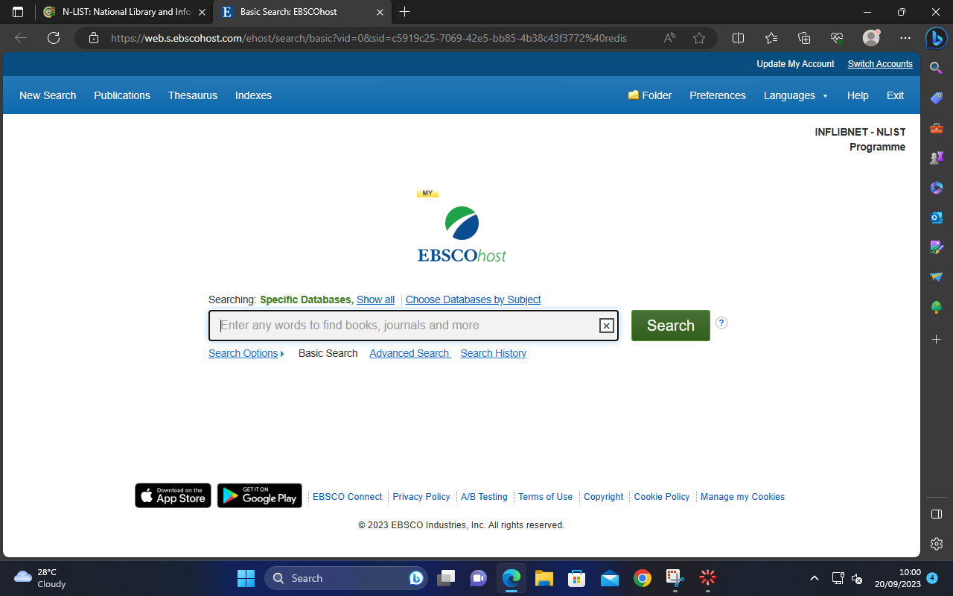

Slide 26
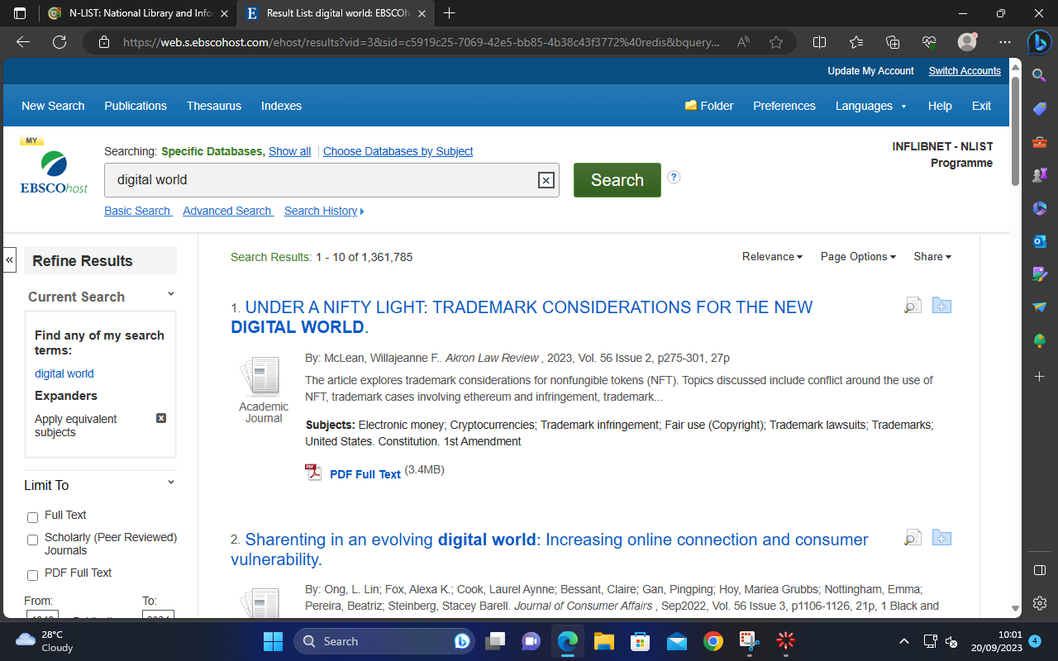

Slide 27
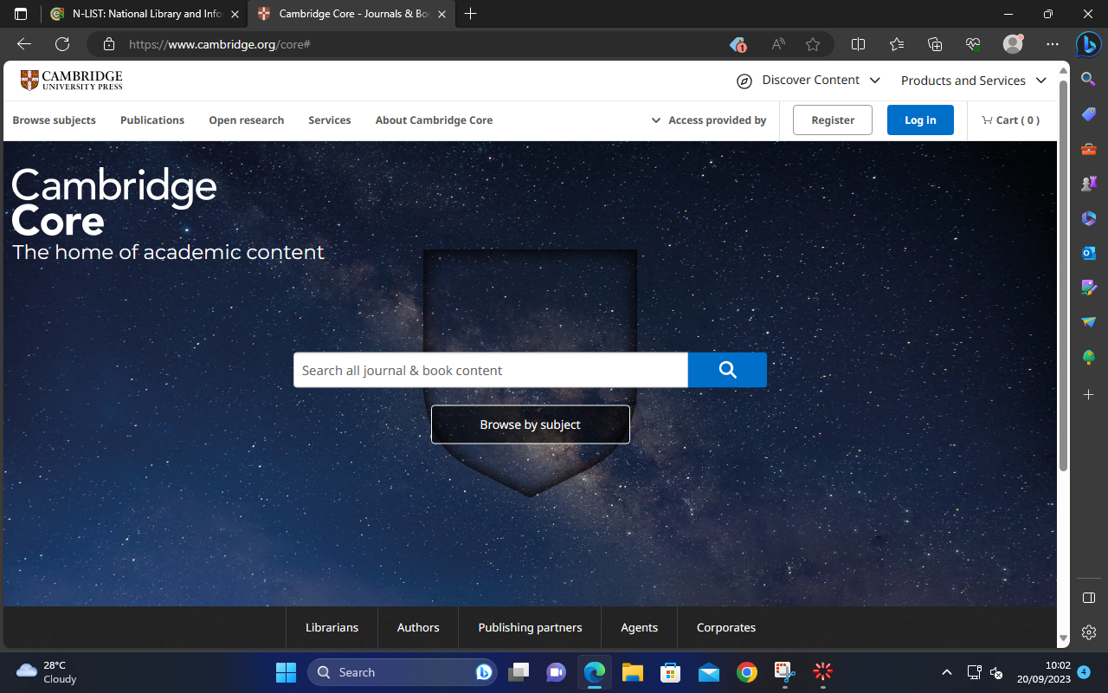

Slide 28
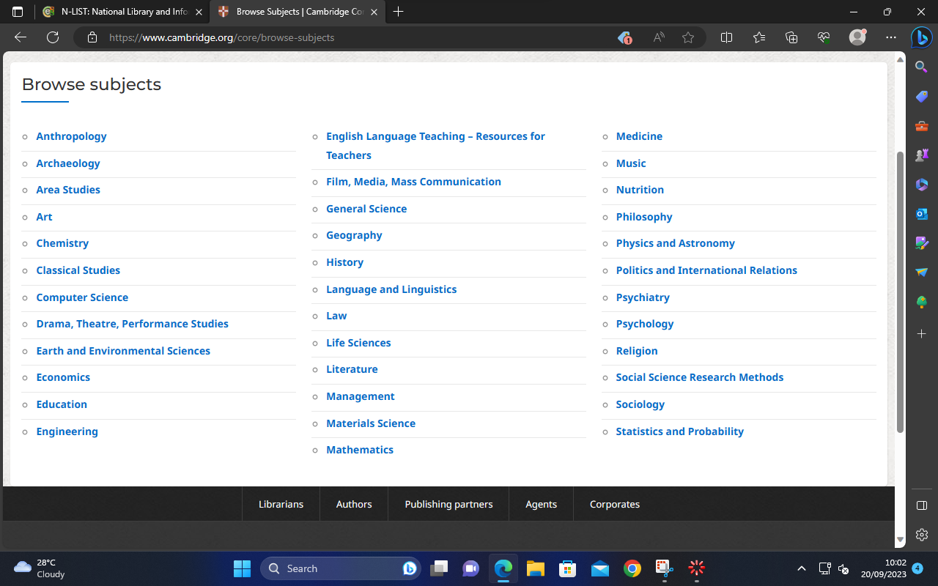

Slide 29
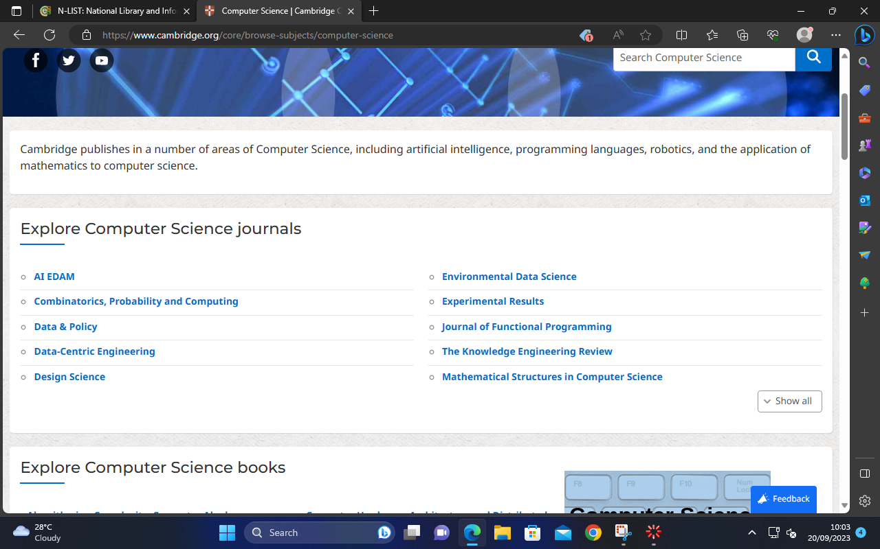
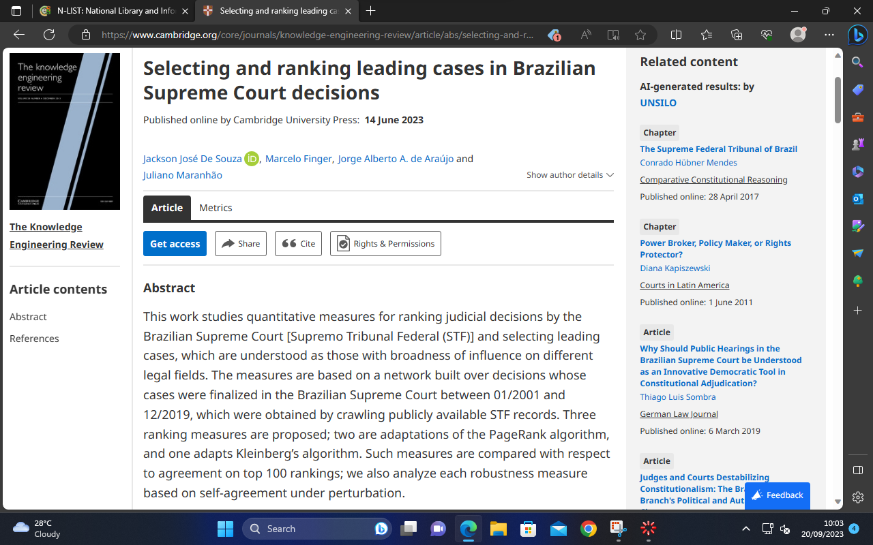

Slide 30
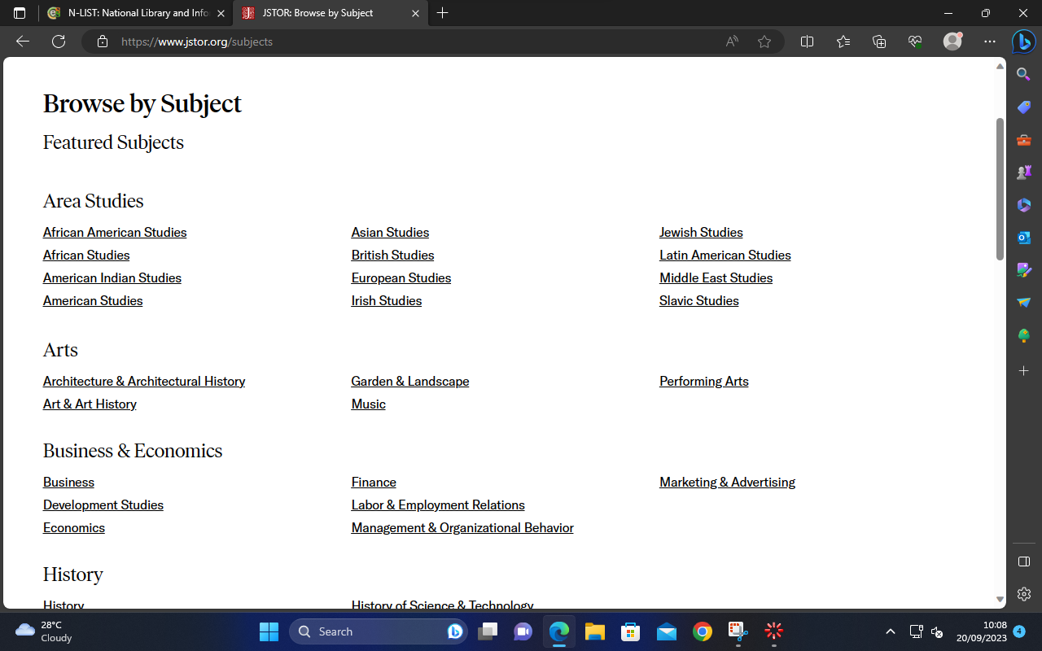
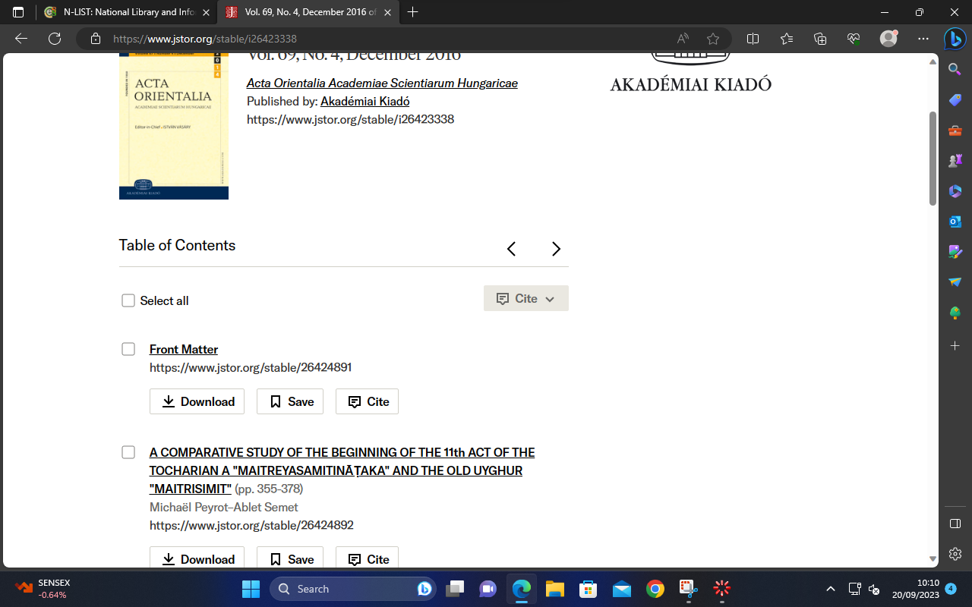

Slide 31
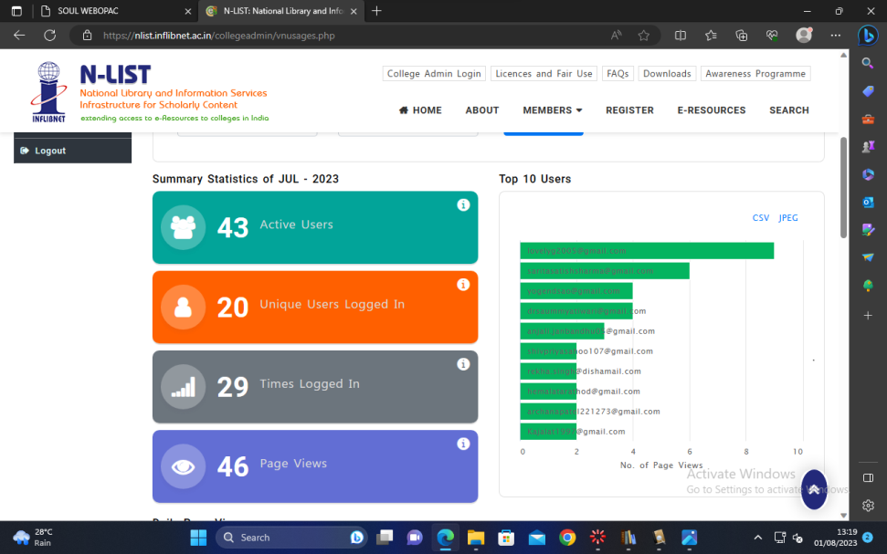
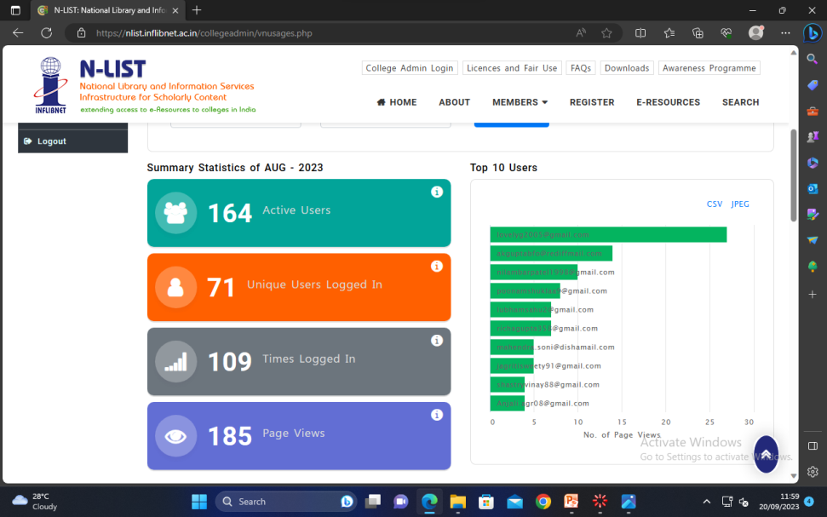
Usage statistics of e-resources by faculty and student in July-August 2023

Slide 32
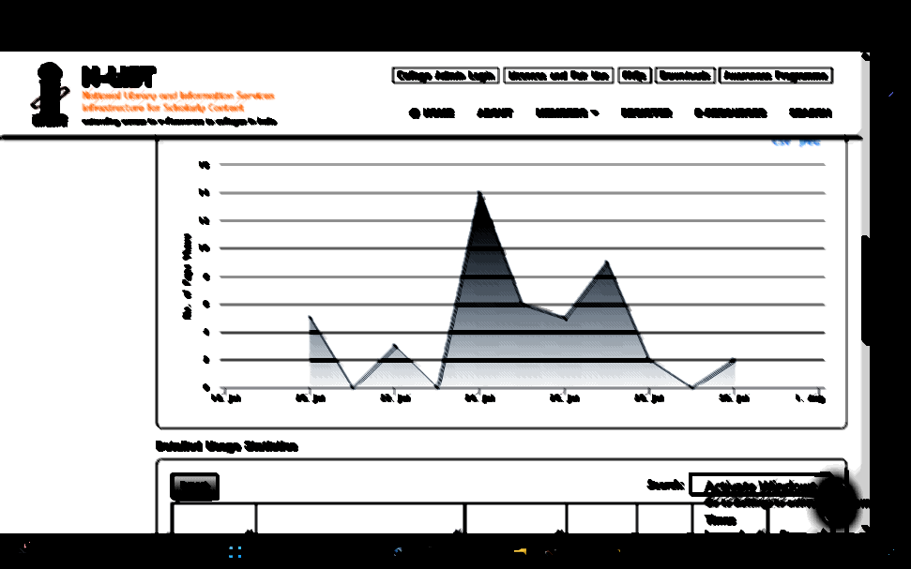
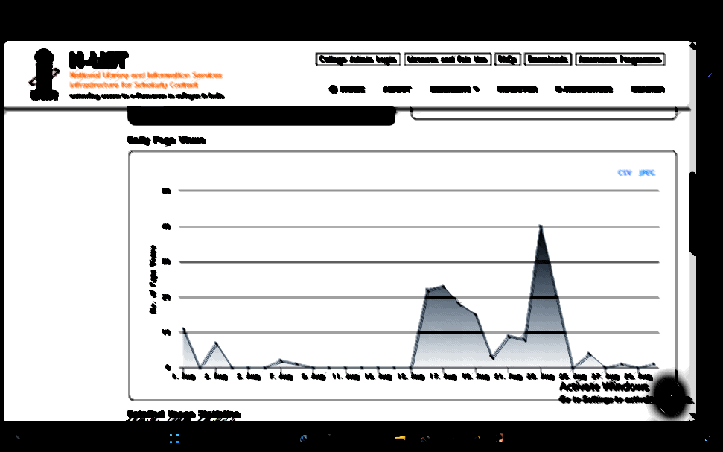
Graphical data representation e-resources use by faculty and student in July-August 2023

Slide 33
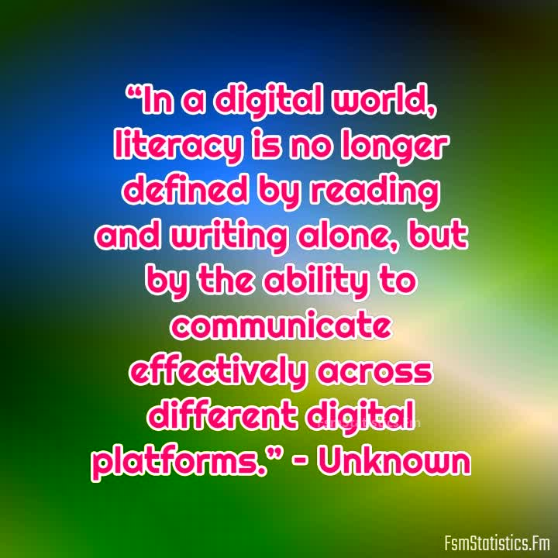
Thank You

